Slide 1
IC1301 -WiPE Optical Power Delivery and Data Transmission in a Wireless and Batteryless Microsystem 29.09.2014
Assoc. Prof. Şenol Mutlu
Boğaziçi Unviersity, Istanbul, Turkey

Slide 2
Main Objective
Solve the low photodiode voltage and conversion efficiency problems associated with optically powered smart microsystems
To demonstrate a compact energy management framework for harvesting optical energy from a LED as well as transmitting data using the same LED.

Slide 3
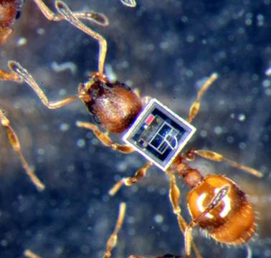
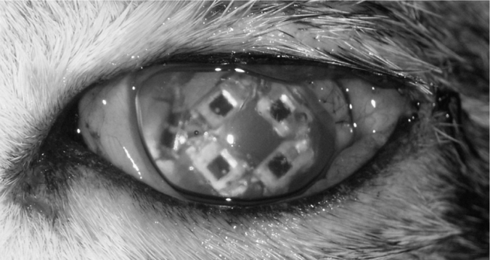
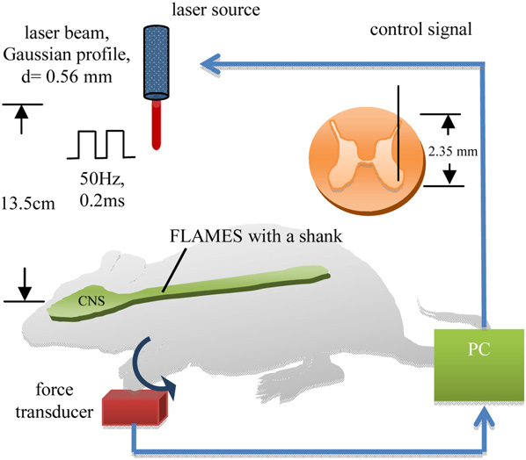
Optical energy harvesting microsystems
Optical (photovoltaic) energy harvesting delivers greatest power in smallest volume
Favorable for wireless, batteryless smart microsystems that are required to be very small (~1 mm³)
Epi-retinal electrical stimulator
powered by an array of PIN diodes [2]
Commercialized IC for
specimen tagging purposes [1]
Individually adressable microstimulators [3]

Slide 4
…but there is a catch
A silicon photodiode can only supply around 0.6V under illumination
This forces designers to use low performance subthreshold digital circuits. Analog circuits are even more problematic!
Connecting on-chip CMOS photodiodes in series is problematic and inefficient [4]
SOI photodiodes can be connected in series without efficiency loss [5]. However, SOI wafers are VERY expensive.
A charge pump can be used to elevate 0.6V to around 1.2V. However, the supply voltage is very close to threshold voltage of the switches; which greatly reduces efficiency [6].
On-chip photodiodes take up expensive silicon real estate. The additional charge pump must be large as well, to support large current loads. This leaves very small area functional blocks such as sensors, processor units, memory, etc.

Slide 5
Transmission of data
A smart microsystem is expected to communicate with its user, transmitting sensor readings, device ID, etc.
Standard silicon photodiodes have NO ability to emit photons. For optical transmission, a LED or laser diode must be used.
Additional antennae for RF transmission increase the overall size.
Typical current microsystem solutions: Optical power transfer, RF data transmission

Slide 6
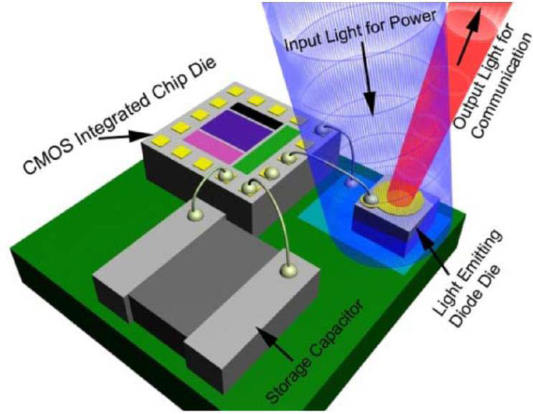
Our solution to the problem
Use a single LED to harvest energy and transmit data
Maximizes the utility of the unavoidable external component
Greater power conversion efficiency
Usable open circuit voltage without need for elevation.
Saves on-chip area

Slide 7
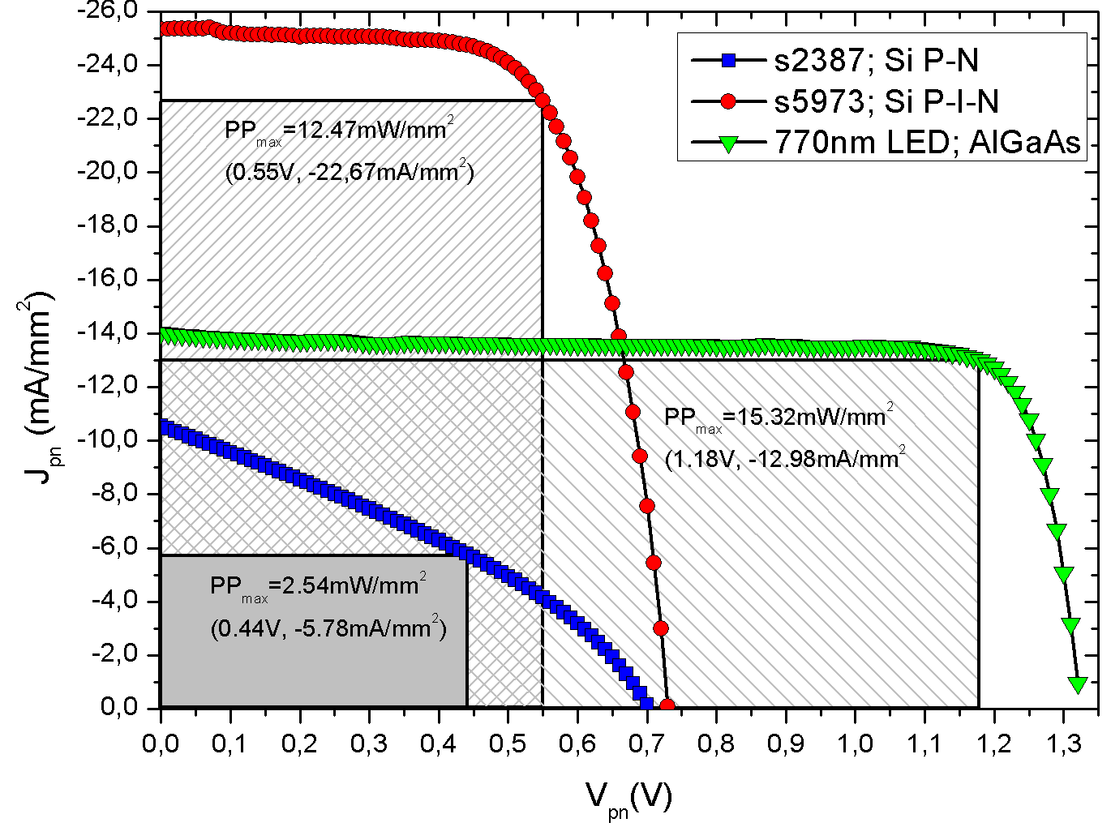
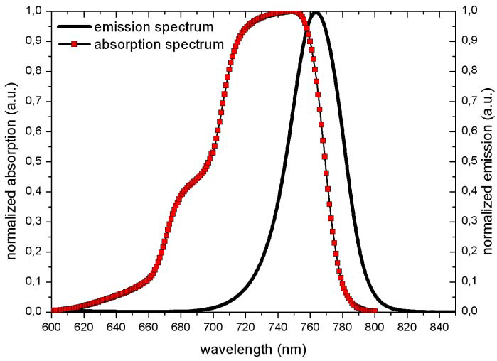
LED as a photovoltaic cell
A 770nm LED is used to collect energy from 660nm laser beam delivering 1.2 V and >1mA. Silicon PIN photodiode can deliver 0.6 V.
LED has 22% optical to electrical energy conversion efficency for this wavelength.
7/17
“A great solar cell has to be a great LED.”
Eli Yablonovitch, “Solar Cell Breaks Efficiency Record”, IEEE Spectrum, 2011.

Slide 8
Transmitting with the LED
The open circuit voltage of the LED must be increased to forward bias it and emit photons.
The elevated voltage will be stored in a large capacitor. Storage capacitor is charged up, and then discharged through the LED to transmit pulses of data.
A means to elevate open-circuit voltage is necessary. Since the load is purely capacitive, a small, low power charge pump optimized for charging the storage capacitor can be used. This minimizes the current consumption and on-chip area usage.

Slide 9
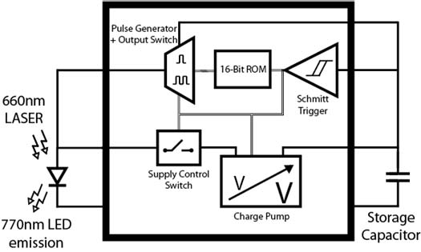
Microsystem design: Elevating the voltage
Charge pump charges up the storage capacitor to approximately twice the LED voltage

Slide 10
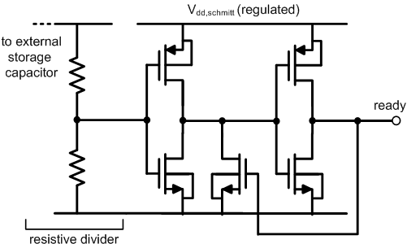
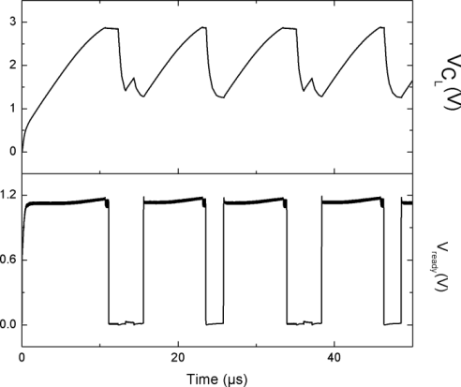
Microsystem design: to transmit or not transmit
Schmitt trigger senses the stored voltage and triggers transmission when enough energy is available.

Slide 11
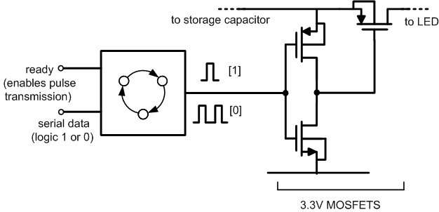
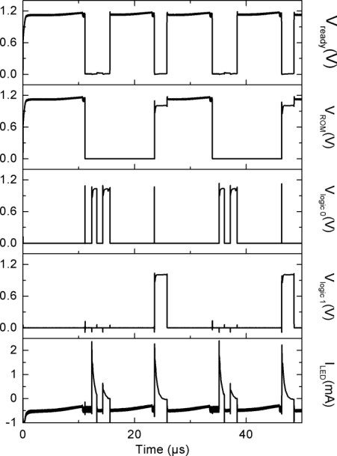
Microsystem design: pulse generation
Single Pulse: Logic 1
Double Pulse: Logic 0
Pulse generator intermittently connects the LED to the storage capacitor. The voltage at the capacitor is high enough to forward bias the LED and transmit optical pulses. Conduction stops when storage capacitor voltage falls below a trigger point, new charge up cycle begins

Slide 12
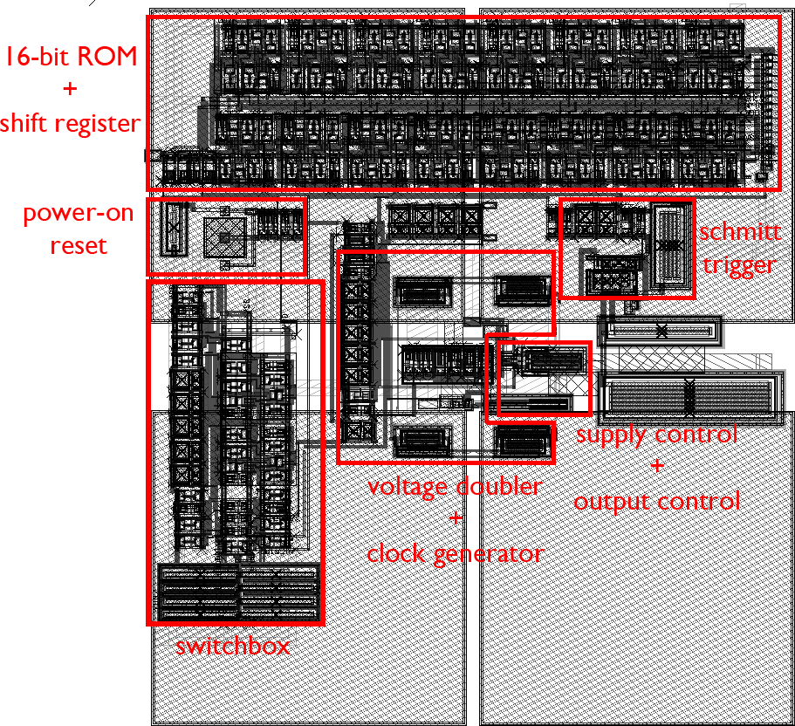
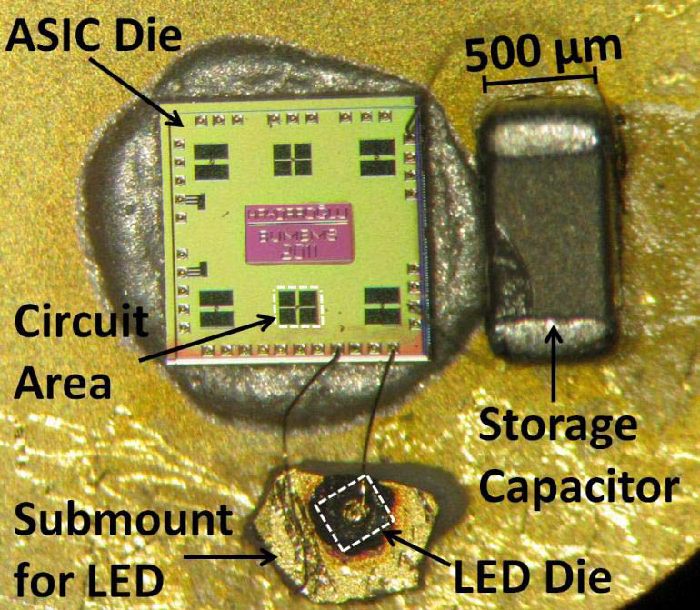
Microsystem: IC layout and integration
The proposed energy management framework minimizes on chip area, leaving large amounts of space available for other functionalities such as sensors, processors, etc.

Slide 13
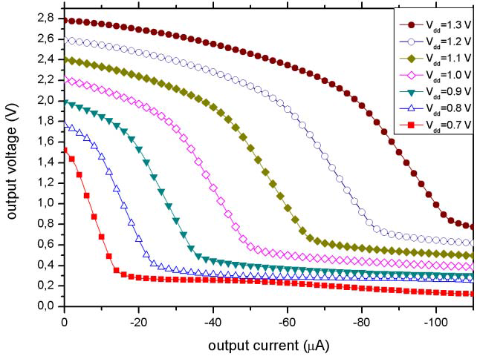
Experimental results: Charge pump
Application specific charge pump can provide energy for optical transmission with LED’s open circuit voltages as low as 0.8V
Power efficiency of the charge pump for these current levels: ~25%

Slide 14
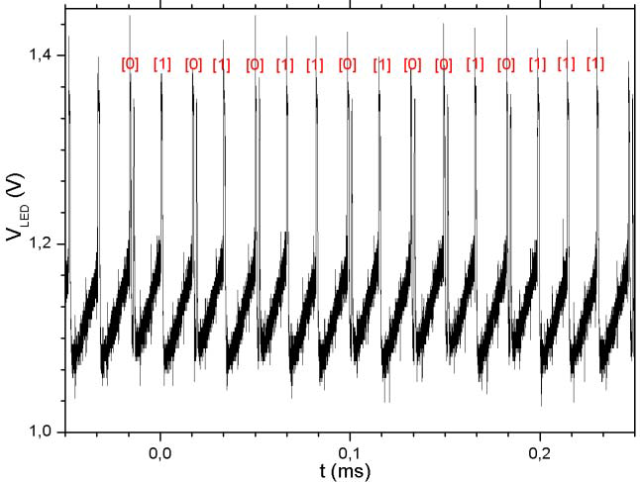
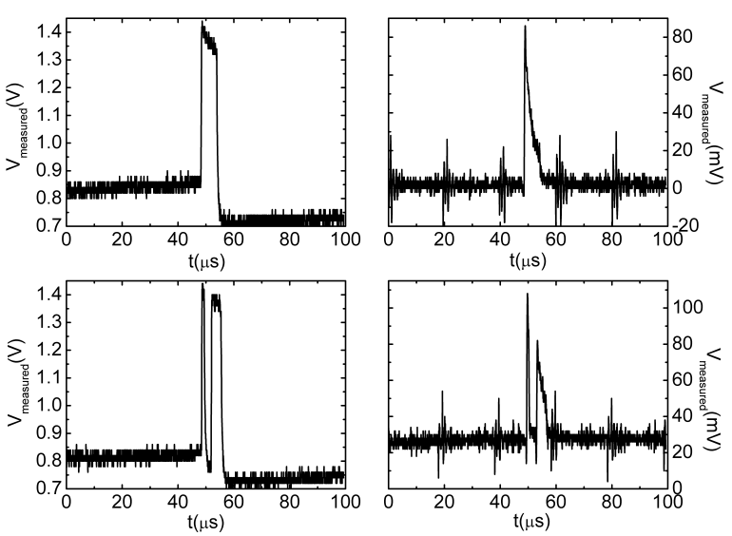
Experimental results: Data transmission
The microsystem transmits a fixed device ID in the prototype. A single pulse of light signifies logic 1, while a quick double pulse means logic 0. One bit (either single or double pulse) is transmitted in each charge up cycle.

Slide 15
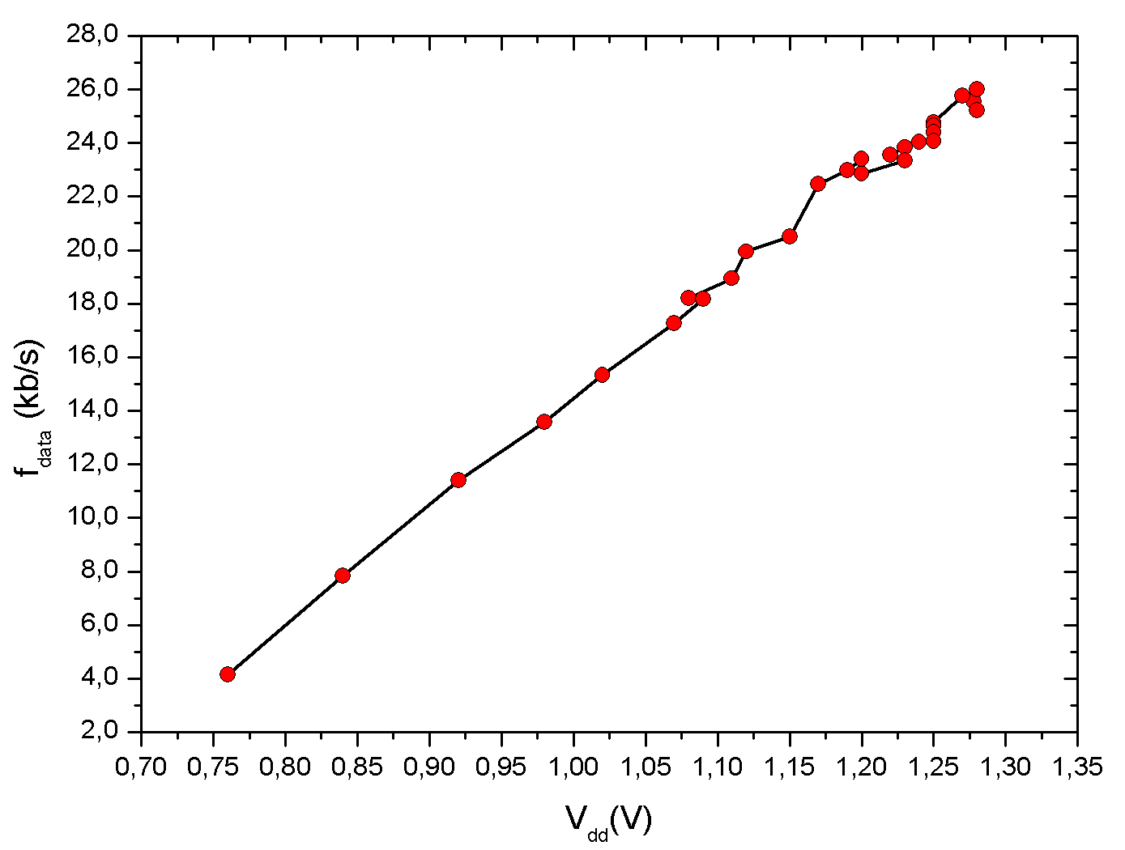
Experimental results: Data rate as an indicator of received illumination
The design is self-timed, self adjusting to available energy level. The data rate of the transmision linearly tracks the supply voltage available to the system. This gives additional feedback to the user, allowing the user to increase the illumination level if needed.

Slide 16
Future work
Integrated high resolution (0.1°C) smart temperature sensor with ADC.
Improved energy management design.
System operation down to 5 μA (instead of ~200 μA in the presented prototype)
Instead of charge pump, use switched capacitors. Conversion efficiency greater than 80%.

Slide 17
References
Acknowledgements
Bogazici University Research Fund BAP 6037, 6520 and 7640 and State Planning Organization TAM Project (2007K120610)
[1] www.pharmaseq.com
[2] T. Schanze et al., IEEE Trans. Biomed. Eng., vol. 54, no. 6, pp. 983–992, Jun. 2007.
[3] M. S. Unlu et al., J. Neural Eng. 8 (2011) 056012 (9pp)
[4] D. O’Brien et al., IEEE J. Sel. Areas Commun., vol. 27, no. 9, pp. 1646–1653, Dec. 2009.
[5] B. A. Warneke et al., Proc. IEEE Sensors, vol. 2. Orlando, FL, USA, Jun. 2002, pp. 1510–1515.
[6] P. Feng and T. Samaddar, Charge Pump Circuit Design. New York, NY, USA: McGraw-Hill, 2006.
[7] B. Sarioglu, et.al. , IEEE Trans. Emerg. Sel. Topics Circuits Syst., vol. 2, no. 4, pp. 683–691, Dec. 2012.
[8] E. Yablonovitch et.al., IEEE J. Photovolt., vol. 2, no. 3, pp. 303–311, Jul. 2012.

